Slide 1
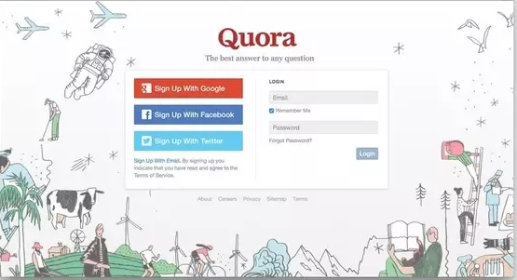

Quora Question Pair Similarity
Mid Project Submission
Mentors:
Sandhya
Abhilash
Team Members:
Sowjanya Bojja
Rinku Soni
Almas Banu
Sohil Sharma

Slide 2
TABLE OF CONTENTS
Problem Statement and Objective
Type of ML Problem
Brief Introduction
Modules Used
About Dataset
Exploratory Data Analysis
Data Pre-Processing
Feature Extraction
Text to Numerical Vector Conversion
Model Building
Model Evaluation
Experiment Tracking using MLFlow
Code conversion to Production Ready Script
Streamlit
Workflow Orchestration using Prefect 2.4
Future Scope

Slide 3
Problem Statement :
Identify which questions asked on Quora are duplicates of questions that have already been asked.
This can be helpful for providing instant responses to questions that have already been addressed.
Objective :
The goal of this project is to predict which of the provided pairs of questions contain two questions with the same meaning.

Slide 4


Type of Machine Learning Problem
It is a binary classification problem, for a given pair of questions we need to predict if they are duplicate or not.

Slide 5
Introduction
Quora is a place to gain and share knowledge—about anything. It’s a platform to ask questions and connect with people who contribute unique insights and quality answers.
One of the major problems that quora face is the duplication of questions. Duplication of question ruins the experience for both the questioner and the answerer. Since the questioner is asking a duplicate question, we can just show him/her the answers to the previous question. And the answerer doesn’t have to repeat his/her answer for essentially the same questions.
In this project, we will solve the Duplication Issue by taking data which contains pair of questions and then apply NLP and Machine Learning on it. We will use NLP in order to preprocess and vectorize the data and then we will classify the pair of question as 1 if it is similar or as 0 if it is a dissimilar pair. For classification we will use ML classification algorithms like logistic Regression, SVM, Random Forest and XGBoost. Finally, we will convert our code to a production ready code, followed by tracking of experiments using MLFlow.

Slide 6
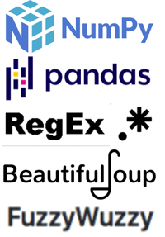


MODULES
USED

Slide 7
.
,
About Dataset :
The given dataset "Train.csv" contains 404,290 rows and 5 columns
Data fields :
id - the id of a training set question pair
qid1, qid2 - unique ids of each question (only available in train.csv)
question1, question2 - the full text of each question.
is_duplicate - is the dependent variable, and the target variable is set to 1 if question1 and question2 have essentially the same meaning, and 0 otherwise.

Slide 8
Exploratory Data Analysis(EDA) :
EDA is applied to investigate the data and summarize the key insights.
It will give you the basic understanding of your data, it’s distribution, null values and much more.
You can either explore data using graphs or through some python functions.
Type of analysis:
Univariate analysis: This type of data consists of only one variable. The analysis of univariate data is thus the simplest form of analysis since the information deals with only one quantity that changes. It does not deal with causes or relationships and the main purpose of the analysis is to describe the data and find patterns that exist within it.
Bi-Variate analysis: This type of data involves two different variables. The analysis of this type of data deals with causes and relationships and the analysis is done to find out the relationship among the two variables.
Multi-Variate analysis: When the data involves three or more variables, it is categorized under multivariate.

Slide 9
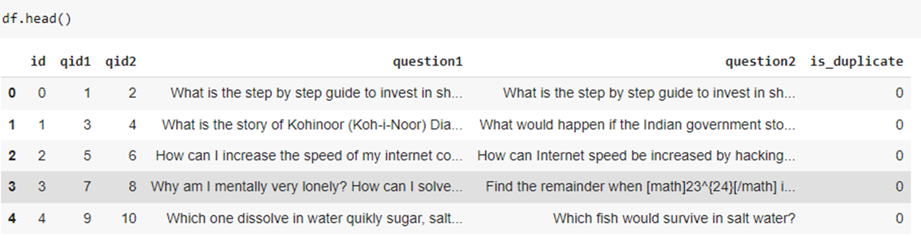
,
Data view : Let’s see how many observations are present in the training dataset. There are about 400 thousand question pairs available in the training dataset.

Slide 10
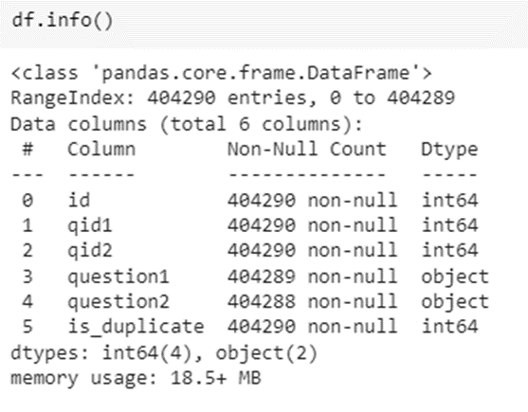
,
2. Basic Information :
The information contains the number of columns, column labels, column data types, memory usage, range index, and the number of cells in each column
(non-null values).

Slide 11
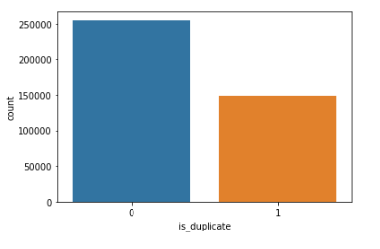
,
3. Distribution of data points among output classes :
No. of non-duplicate data points(0) are 255027 and No. of duplicate data points(1) are 149263.
Figure shows Barplot of Number of duplicate(similar) and non-duplicate(non similar) questions.
We have 404290 training data points. And only 36.92% are positive. That means it is an imbalanced dataset.

Slide 12
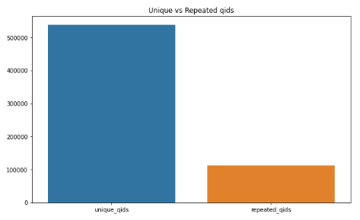
,
4. Analysis of qid columns :
Total no. unique and repeated qids are 537933 and 111780 respectively.

Slide 13
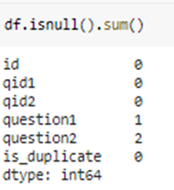
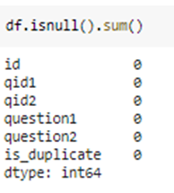
,
5. Checking NULL values:
There are three null values in our dataset of which one is in question1 and rest two are in question2.
6. Filling null values:
To deal with null values we have filled them using df.fillna('')

Slide 14
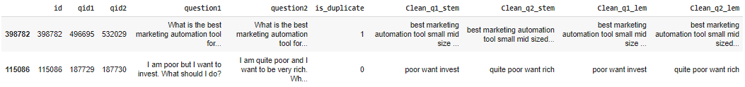
,
Data Preprocessing
We have performed the below steps on question1 and question2 columns of the dataset:
Convert entire text to lowercase using “lower() function”.
Replace Special Characters and some numbers with their respective string equivalents using “replace() function”.
Remove Special Characters using “regex”.
Expanding Contractions by first defining them and then replacing it.
Remove html tags using “beautifulsoup”.
Remove Punctuations using “regex”
Remove Stopwords using “nltk-stopwords”.
Apply Tokenization using “split() function”.
Apply Stemming using “nltk-PorterStemmer”.
Apply Lemmatization using “nltk-wordnetLemmatizer”.
After applying all the above steps data frame looks like:

Slide 15
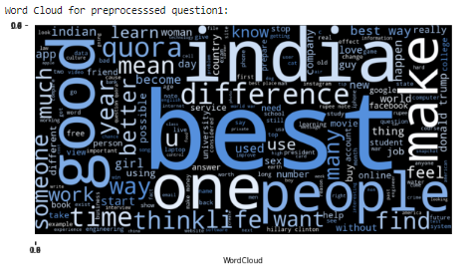
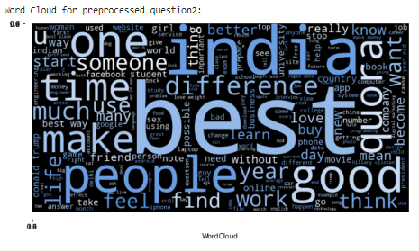
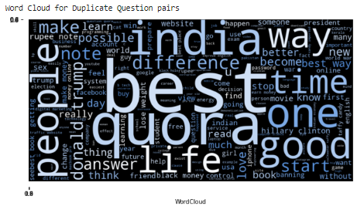
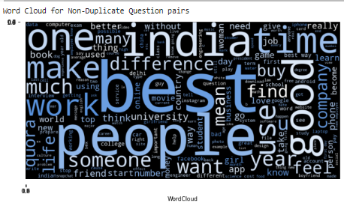
,
Word Cloud for Preprocessed question1
Word Cloud for Preprocessed question1
Word Clouds
Word Cloud for duplicate question pairs
Word Cloud for non duplicate question pairs

Slide 16
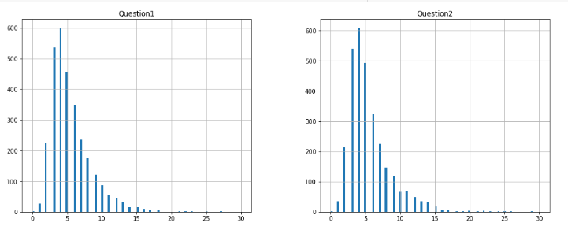
Count Plot of length of words in Clean_q1_lem and Clean_q2_lem
We can notice that almost 99% of words are in range 0 to 15 for both Question1 and Question2.
And they are very few questions in both Question1 and Question2 that have count of words greater than 15.

Slide 17
,
Feature Extraction:
Feature extraction refers to the process of transforming raw data into numerical features that can be processed while preserving the information in the original data set. It yields better results than applying machine learning directly to the raw data.
We have divided this step in three parts :
Basic Features : These features are extracted from preprocessed question1 and question2.
StopWords and Token Features : These features are extracted based on stopwords and tokens from original question1 and question2.
Fuzzy Features : These features are extracted from fuzzywords of preprocessed question1 and question2.

Slide 18
,
Basic Features
Q1_char : count of characters of Question1
Q2_char : count of characters of Question2
Q1_n_words : Count of words in Question 1
Q2_n_words : Count of words in Question 2
total_word_num : Sum of Q1_n_words and Q2_n_words
diff_word_num : absolute difference of Q1_n_words and Q2_n_words
same_first_word : This feature is 1 if both questions have same first word otherwise 0.
same_last_word : This feature is 1 if both questions have same last word otherwise 0.
unique_common_words : Count of unique words which are common for both Question 1 and Question 2
same_common_words : Count of words which are same and common for both Question 1 and Question2
total_unique_word_share : (unique_common_words)/(total_word_num)
total_same_word_share : (same_common_words)/(unique_common_words)
min_common_word_ratio : Same_common_words divided by minimum number of words between question 1 and question 2.
max_common_word_ratio : Same_common_words divided by maximum number of words between question 1 and question 2.

Slide 19
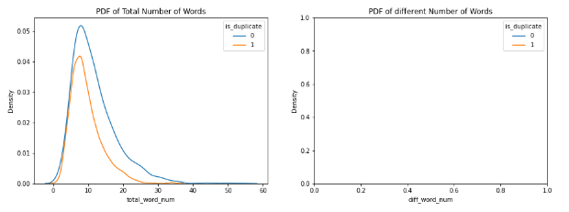
,
Visualization of Basic Features
Number of words in question1 for duplicate & non-duplicate question pairs have an overlapping distribution and Sample dataframe doesn’t contains different number of words which suggests that both the features might not be useful for classifying the question pairs to be either duplicate or non-duplicate.

Slide 20
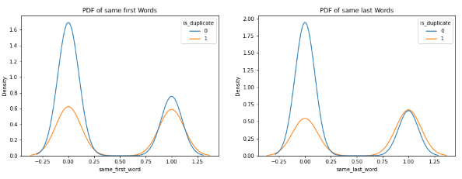
,
If First word or Last word is the same then there is a high chance that the question pairs are duplicates.

Slide 21
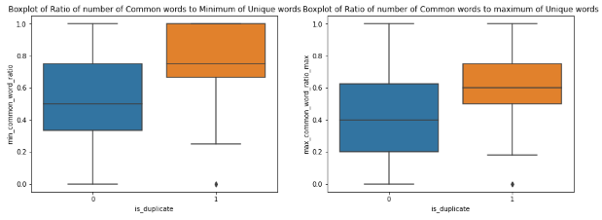
,
For duplicate question pairs, the total unique words to total words ratio is generally smaller.

Slide 22
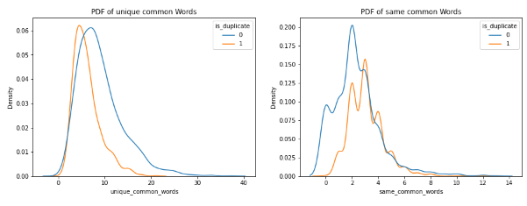
,
The number of total unique words (q1 and q2 both combined) is less if question pairs are duplicate.

Slide 23
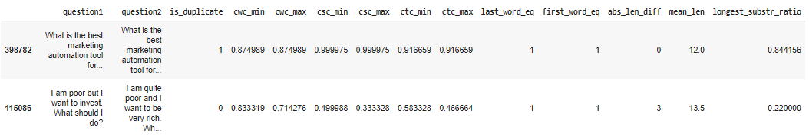
,
2. StopWords and Tokens Features :
cwc_min : Ratio of common_word_count to min length of word count of Q1 and Q2
cwc_max : Ratio of common_word_count to max length of word count of Q1 and Q2
csc_min : Ratio of common_stop_count to min length of stop count of Q1 and Q2
csc_max : Ratio of common_stop_count to max length of stop count of Q1 and Q2
ctc_min : Ratio of common_token_count to min length of token count of Q1 and Q2
ctc_max : Ratio of common_token_count to max length of token count of Q1 and Q2
last_word_eq : Check if Last word of both questions is equal or not
first_word_eq : Check if First word of both questions is equal or not
abs_len_diff : Abs. length difference
mean_len : Average Token Length of both Questions
longest_substr_ratio : Ratio of length longest common substring to min length of token count of Q1 and Q2

Slide 24
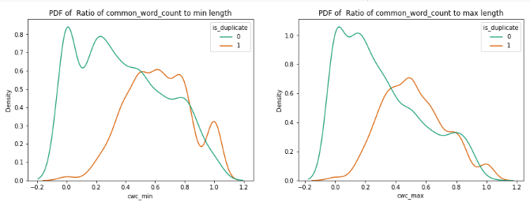
,
Visualization of StopWords & Token features

Slide 25
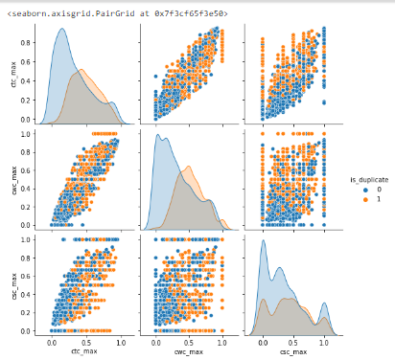
,
Pair Plot of ctc_max, cwc_max, csc_max

Slide 26
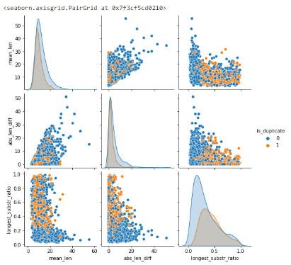
,
Pair Plot mean_len, abs_len_diff, longest_substr_ratio

Slide 27
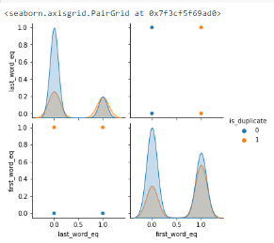
,
Observation: We can observe that the distribution of all these features are Overlapping for duplicate & Non-duplicate Question Pairs.
So these features may not be useful in separating the duplicate & non-duplicate question pairs. Hence, we will not consider them for modelling.

Slide 28
,
3. Fuzzy Features :
We have extracted fuzz_ratio, fuzz_partial_ratio, fuzz_token_set_ratio and fuzz_token_sort_ratio features with fuzzywuzzy string matching tool.
What is Fuzzy String Matching?
Fuzzy string matching is the technique of finding strings that match with a given string partially and not exactly.
When a user misspells a word or enters a word partially, fuzzy string matching helps in finding the right word – as we see in search engines.
List of features:
fuzz_ratio : fuzzyWuzzy has a ratio function that calculates the standard Levenshtein distance similarity ratio between two sequences.
fuzz_partial_ratio : The partial ratio helps us to perform substring matching. This takes the shortest string and compares it with all the substrings of the same length.
token_set_ratio : Token set ratio performs a set operation that takes out the common tokens instead of just tokenizing the strings, sorting, and then pasting the tokens back together. Extra or same repeated words do not matter.
token_sort_ratio : In token sort ratio, the strings are tokenized and pre-processed by converting to lower case and getting rid of punctuation. The strings are then sorted alphabetically and joined together. Post this, the Levenshtein distance similarity ratio is calculated between the strings.

Slide 29
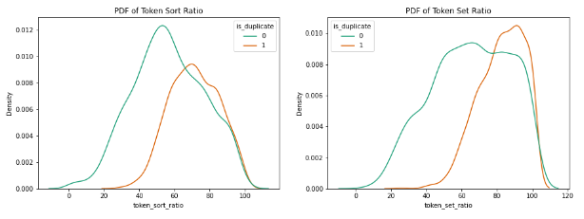
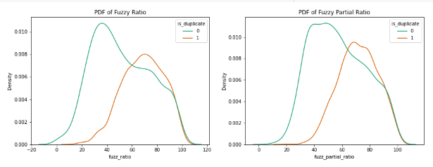
,
Visualization of features :
All of these Fuzzy Based Ratios are higher for Duplicate Question Pairs relative to Non-Duplicate Question Pairs.

Slide 30
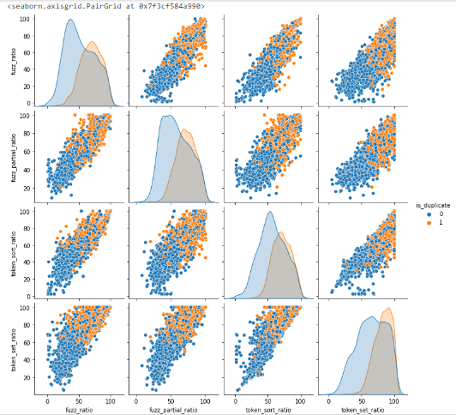

Slide 31
Natural Language Processing
Natural Language Processing (NLP) is concerned with giving Machines the ability to understand Text and Spoken words in much the same way human beings can.
NLP combines rule-based modeling of Human Language—with statistical, machine learning, and deep learning models. Together, these technologies enable computers to process human language in the form of text or voice data and to ‘understand’ its full meaning, complete with the speaker or writer’s intent and sentiment. Use Cases for NLP can be :
Spam Detection
Machine Translation
Virtual Agents and Chatbots
Social Media Sentiment Analysis and Text Summarization

Slide 32
Bag Of Words
Bag-Of-Word is a way of representing Text Data when modeling text with ML Algorithms.
BOW Approach :
1. Learn the Vocabulary
2. Transform the Data
The Bag-Of-Words Model converts our Data into a Matrix Representation for Training our Models.

Slide 33
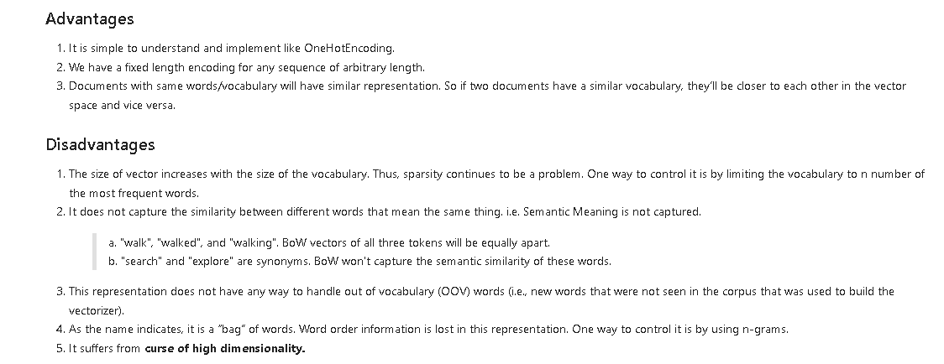

Slide 34
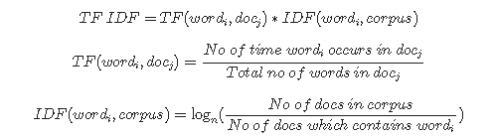
Term Frequency Inverse Document Frequency
TFIDF is a Numerical Statistic that is intended to reflect how important a word is to a document in a collection or corpus It is often used as a weighting factor in searches of information retrieval. The TF–IDF value increases with the number of times a word appears in the document and is offset by the number of documents in the corpus that contain the word. TFIDF Scores are in the range of 0 to 1.
Output from TFIDF is a Document Term Matrix , representing the TFIDF Scores of each Vocabulary for every Document present in our Dataset.

Slide 35
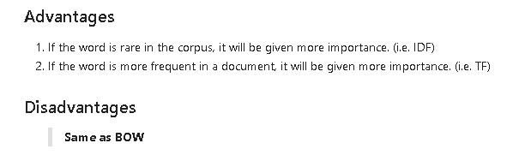

Slide 36
Word2Vec
The Word2Vec Model is used to extract the notion of relatedness across words or products such as semantic relatedness, synonym detection, concept categorization, selection preferences, and analogy.
A Word2Vec model learns meaningful relations and encodes the relatedness into vector similarity.
In Word2Vec , GLove , Documents are converted into Word Embeddings, where Sparsity is large and Dimensions are lower.
Unlike in other Techniques , we can generate our Vector as per our Size Requirement, such that the Accuracy / Precision remains almost the Same , compared with other Techniques.
N – Dimensional Word Vector for a Document can be found by taking the Mean / Average of the N – Dimensional Vectors of each Word present in that Document, thus utlizing the Same Amount of Space.

Slide 37
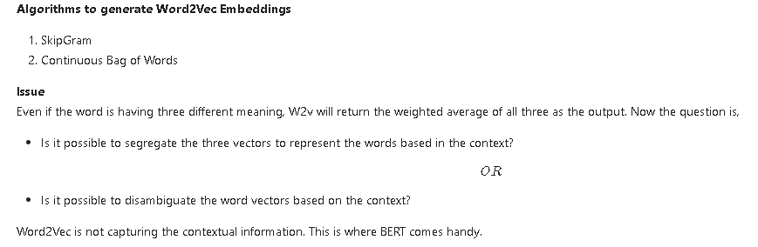

Slide 38
GLove (Global Vectors)
Both Word2vec and GLove enable us to represent a word in the form of a vector (often called embedding). They are the two most popular algorithms for word embeddings that bring out the semantic similarity of words that captures different facets of the meaning of a word.
But , Word2vec embeddings are based on training a shallow feedforward neural network while glove embeddings are learnt based on matrix factorization techniques. In Word2Vec , GLove , Documents are converted into Word Embeddings, where Sparsity is large and Dimensions are lower.
Glove is based on matrix factorization techniques on the word-context matrix. It first constructs a large matrix of (words x context) co-occurrence information, i.e. for each “word” (the rows), you count how frequently we see this word in some “context” (the columns) in a large corpus.
The number of “contexts” is of course large, since it is essentially combinatorial in size. Also, we can attain the Similarity Score between 2 words as well , using PCA Technique in Word2Vec Approach.

Slide 39
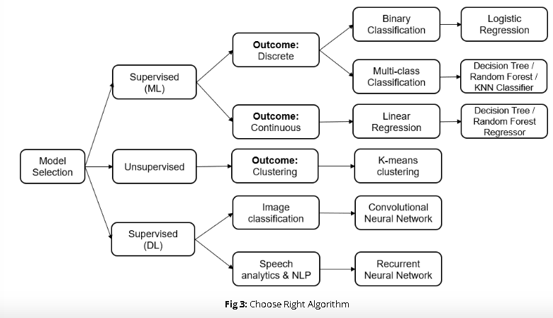
Model Building
Model Building is the process of developing a Probabilistic Model that best describes the relationship between the dependent and independent variables.
Building an ML Model requires splitting of data into two sets, such as ‘training set’ and ‘testing set’ in the ratio of 80:20 or 70:30; A set of supervised (for labelled data) and unsupervised (for unlabeled data) algorithms are available to choose from depending on the nature of input data and business outcome to predict.

Slide 40
Model Evaluation
Model evaluation is the process of using different evaluation metrics to understand a machine learning model's performance, as well as its strengths and weaknesses. Model evaluation is important to assess the efficacy of a model during initial research phases, and it also plays a role in model monitoring.
There are several metrics to be considered while choosing a Particular Model , like Classification Report (measures the performance of our Machine Learning classification model, using Accuracy , Precision , Recall , F1 Score) and Confusion Matrix (measures an estimation between Actual and Predicted Values).

Slide 41
Experiment Tracking using MLFlow
MLFlow helps you to organize your experiments into runs.
By automating the entire ML model life cycle from integration to deployment to monitoring, MLOps enables faster and more reliable delivery of machine learning models. In addition, MLOps can help organizations track and audit the changes made to models and improve model management.
MLOps can help organizations improve the quality of their machine learning models and speed up the development process
MLOps can help to reduce the risks associated with machine learning development and deployment. By automating the ML model life cycle, MLOps can help to improve the accuracy of machine learning models and make the development process more efficient.

Slide 42
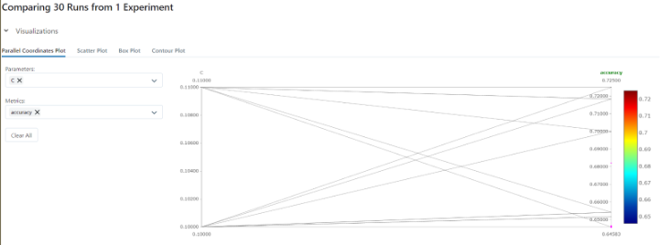
MLFlow Outputs

Slide 43
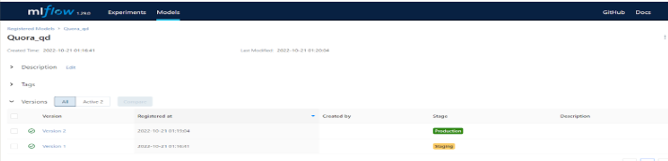
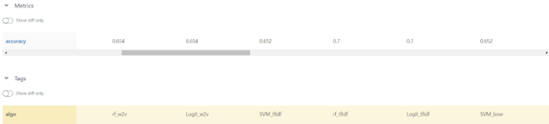

Slide 44
Streamlit
Streamlit is an open-source app framework for creating and deploying Data Science Web Applications.
It helps us create web apps for data science and machine learning in a short time. It is compatible with major Python libraries such as scikit-learn, Keras, PyTorch, SymPy(latex), NumPy, pandas, Matplotlib etc.
Streamlit makes it easy for you to visualize, mutate, and share data. The API reference is organized by activity type, like displaying data or optimizing performance. Each section includes methods associated with the activity type, including examples.
It can be easily used to interact with your, data, models or visualizations.

Slide 45
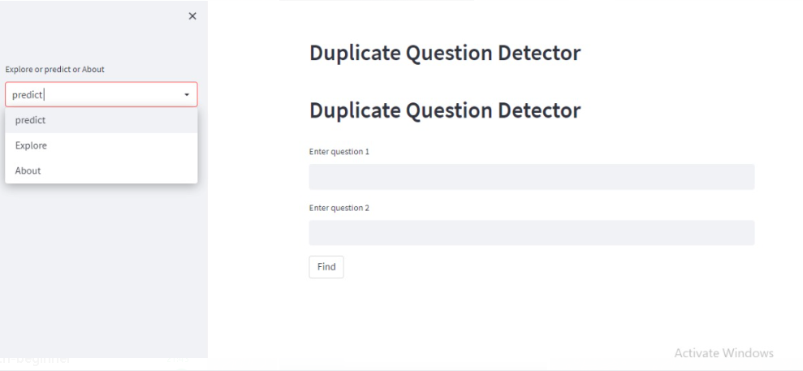
Streamlit Output:

Slide 46
,
Future Scope
Improve the accuracy using Deep Learning Based Models.
Ability to extend this Project to various Search Applications.

Slide 47


